Slide 1

Gesture-Controlled Smart Home Automation
Experience the future of home automation with intuitive, touch-free gesture controls. This system brings convenience and accessibility to your fingertips, enhancing daily living through simple hand movements.

Slide 2





Why Gesture Control?
Touch-Free Operation
Eliminate physical contact for hygienic and convenient interaction.
Ease of Use
Simple, natural hand movements make control effortless for everyone.
Enhanced Accessibility
Provides an alternative control method for users with limited mobility.
Modern Living
Integrate cutting-edge technology into your daily environment.

Slide 3
Project Objectives: Crafting a Smarter Home
Intuitive Appliance Control
Hands-Free Recipe Assistant
Real-time Status Feedback
Design a gesture-based system for seamless interaction with home appliances.
Implement a digital assistant for cooking, allowing touch-free recipe navigation.
Display immediate appliance status on an OLED screen for clarity.
Remote Monitoring & Control
Cost-Effective & Scalable
Deliver an efficient smart home prototype that is both affordable and expandable.
Enable cloud-based services for monitoring and controlling devices from anywhere.

Slide 4

System Overview: How It Works
The system leverages the APDS-9960 gesture sensor to detect precise hand movements. Each gesture is carefully mapped to a specific action, providing an intuitive and responsive control experience.
Up Gesture: Toggles the main light ON/OFF.
Down Gesture: Turns the fan ON/OFF.
Left Gesture: Cycles through various digital recipes (e.g., Omelette, Tea).
Right Gesture: Advances to the next cooking step within a recipe.
The ESP32 microcontroller processes this data and controls appliances via relay modules, while an OLED display provides real-time status. Blynk IoT allows remote monitoring and control through a mobile app.

Slide 5






Key Highlights: Advanced Features
Gesture-Based Control
Real-time OLED Updates
Seamless, touch-free operation for all connected appliances.
Instant visual feedback on appliance status and recipe steps.
Cloud-Based Monitoring
Wireless Connectivity
Access and control your smart home from anywhere via Blynk IoT.
Integrated Wi-Fi for reliable and flexible network integration.
Expandable Architecture
Digital Recipe Assistant
Designed for easy integration of future devices and functionalities.
Hands-free guidance for culinary tasks, right in your kitchen.

Slide 6
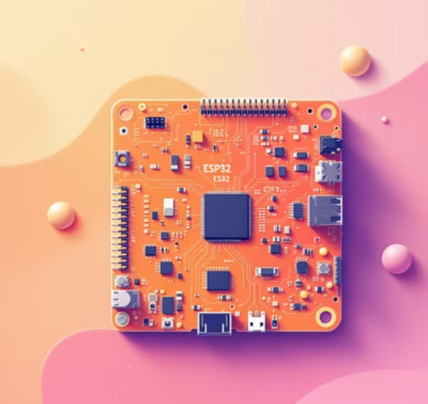
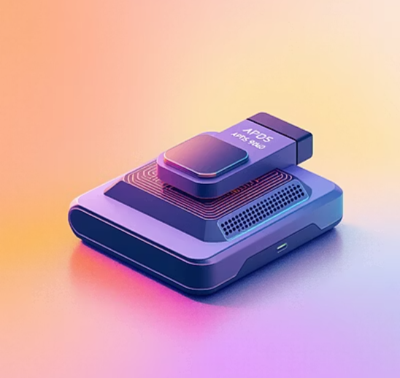
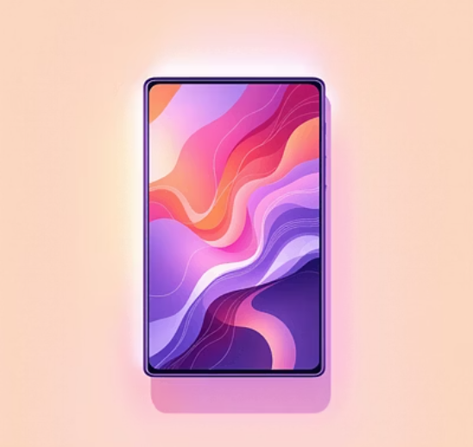
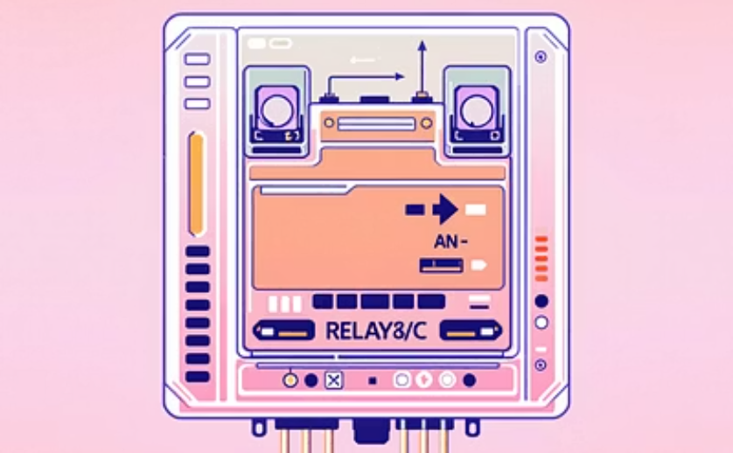

Hardware Components: The Building Blocks
ESP32 Development Board: The brain of the system, offering Wi-Fi and Bluetooth capabilities.
APDS-9960 Gesture Sensor: Detects ambient light, RGB color, and four-directional gestures.
OLED Display (SSD1306): A compact screen for clear, real-time information.
Relay Module: Enables the ESP32 to control higher voltage appliances like lights and fans.
Light and Fan (Load): Standard household appliances for demonstration.
Buzzer: Provides acoustic feedback for gesture detection and system status.

Slide 7
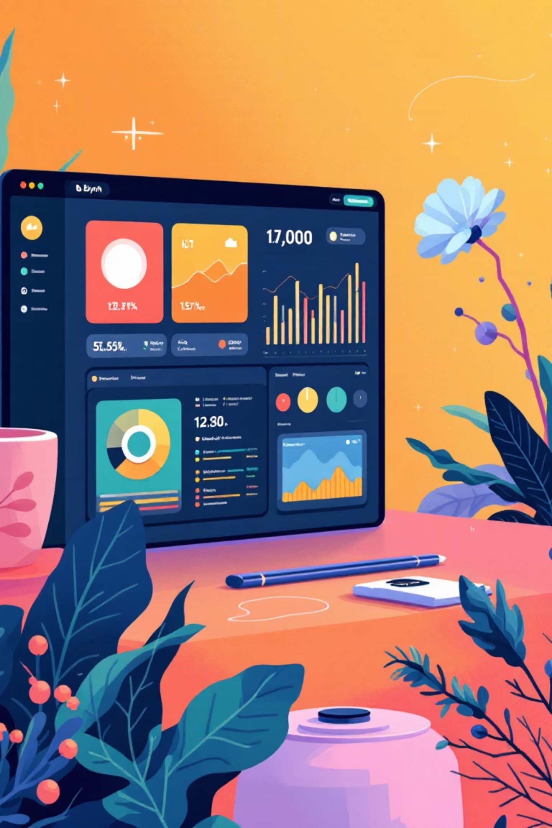
Software & Communication: Bringing It to Life
Arduino Framework
Blynk IoT Cloud
The primary development environment for programming the ESP32.
Platform for remote control, monitoring, and data visualization.
I²C Communication
Protocol for efficient data exchange between the ESP32, OLED, and APDS-9960.

Slide 8
Pin Configuration: Connecting the Hardware
Component
ESP32 Pin
I/O Type
Connection / Role
LED
GPIO 2
Output
Status Light
Buzzer
GPIO 19
Output
Audio feedback for gestures
Fan (Relay)
GPIO 25
Output
Active LOW (Low = ON)
OLED SDA
GPIO 32
I2C (Bus 0)
Data line for display
OLED SCL
GPIO 33
I2C (Bus 0)
Clock line for display
Sensor SDA
GPIO 21
I2C (Bus 1)
Data line for APDS9960
Sensor SCL
GPIO 22
I2C (Bus 1)
Clock line for APDS9960
This pin configuration ensures proper communication and control between the ESP32 and all connected peripherals, forming the backbone of the gesture control system.

Slide 9

Development Tools: The Engineer's Toolkit
1
2
PlatformIO (VS Code Extension)
Arduino Framework for ESP32
A powerful, cross-platform IDE for IoT development, integrated with Visual Studio Code.
Simplifies programming the ESP32 with an extensive library ecosystem.
3
4
Blynk IoT Mobile Application
Serial Monitor for Debugging
Provides a user-friendly interface for remote interaction and real-time data visualization.
Essential for real-time data inspection and troubleshooting during development.

Slide 10

Conclusion: The Future of Smart Living
This project successfully demonstrates a highly functional gesture-controlled smart home system. By seamlessly integrating the ESP32, APDS-9960 sensor, OLED display, and Blynk Cloud, we've created an intuitive solution that offers both local and remote appliance control, alongside a valuable digital kitchen assistant.
This innovative system is not only cost-effective and energy-efficient but also boasts a user-friendly and scalable design, making it an ideal prototype for modern smart home applications and further research into human-computer interaction.

